Slide 1
DATA STRUCTUREs
Subject Code -18B11CI311
L-T scheme: 3-1 and Credits: 4

Slide 2
Syllabus
Introduction to Data Structures
Algorithm and Complexity
Array
Searching And Sorting Algorithms
Stack
Queue
Linked List
Graph and Tree

Slide 3
Recommended Books
Text Books:
Sartaj Sahni, “Data Structures, Algorithms”, Tata Mc Graw Hill, New York
E Balagurusamy,”Data Structures using C”, McGraw Hill
Narasimha Karumanchi, “Data Structures and Algorithms”, CareerMonk Publication
Reference Books:
Corman et al., “Introduction to Algorithms”, MIT Press
S. Dasgupta et al., “Algorithms”, McGraw-Hill
Kruse, Tonso, Leung, “Data Structures and Program Design in C”, Pearson
Langsam, Augestein, Tanenbaum, “Data Structures using C and C++”, Pearson
Weiss, “Data Structures and Algorithm Analysis in C/C++”, Pearson

Slide 4
Marks Distribution(Data Structures)
Component & Nature | Duration | Marks / Weightage
T1 | 1 hr | 15
T2 | 1&1/2 hrs | 25
T3 | 2hrs | 35
Tutorials |  | 05
Attendance |  | 05
Quiz |  | 05
Assignments |  | 10
Total |  | 100

Slide 5
Marks Distribution(Data Structures Lab)
Component & Nature | Duration | Marks / Weightage
P1 (Mid sem lab – Viva/Test) | 2 hrs | 15
P2 (Mid sem lab – Viva/Test) | 2 hrs | 15
Continuous Evaluation(Lab work ) |  | 40
Lab record |  | 15
Attendance & discipline in lab |  | 15
Total |  | 100

Slide 6
Prerequisite Knowledge
Basic programming constructs from C programming, like data types, operators, decision control, loops, string and functions etc.
Dynamic memory allocation
Pointers
Structures

Slide 7
Introduction
to
Data Structures

Slide 8
Why This Course?
Students will be able to write fast programs
Students will be able to solve new problems
Students will be able to evaluate the quality of a program (Analysis of Algorithms: Running time and memory space )
Students will be able to give non-trivial methods to solve problems.

Slide 9


Preface of Data structure
Data: simply a value or a set of values of different types which is called data types like string, integer, char etc.
Structure: Way of organizing information, so that it is easier to use.
Data Structure ?
A data structure is a particular way of organizing data in a computer memory so that it can be used efficiently.
Although computers can perform millions of mathematical computations per second, when a problem gets larger and complicated, the performance can be an important consideration.
One of the most crucial aspects to how quickly a problem can be solved is how the data is stored in memory.
Unorganized room
Well organized room

Slide 10
Classification of Data Structure: Classification 1
Primitive data structure/types: Basic data types available in programming languages.
Examples: integers, floats ,doubles, etc.
Simple data structure: Simple data structure can be constructed with the help of primitive data structures.
Examples: Array and Linked list.
Compound Data Structure: Compound data structure can be constructed with the help of any one of the primitive or simple data structure and it is having a specific functionality.
Examples: Stack, Queue, Tree, Graph

Slide 11
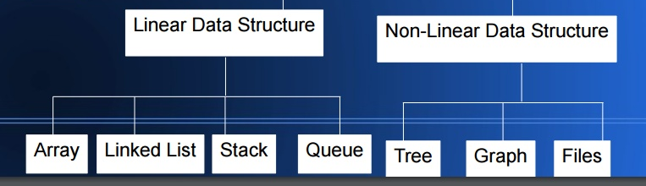
Classification of Data Structure: : Classification 2

Slide 12
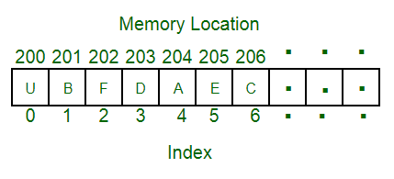
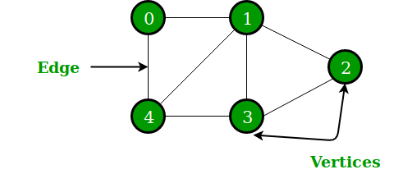
Linear Vs Non-linear Data Structures
Linear Data Structures: A linear data structure traverses the data elements sequentially, in which only one data element can directly be reached.
Examples: Array, Linked List
Non-Linear Data Structures: Every data item is attached to several other data items. The data items are not arranged in a sequential structure.
Examples: Tree, Graph

Slide 13
Operations on Data Structures
Basic operations –
Traversing – Accessing and processing record exactly once
Insertion – Adding new record to data structure
Deletion – Removing particular record from the data structure
Searching – Finding the location of the record in data structure
Special operations –
Sorting – Arranging the record in some specific order
Merging – Combining the records from different data structures to a single data structure

Slide 14
Commonly used data structures
Array
Linked list
Stack
Queue
Tree
Graph
Note: No single data structure works well for all purposes, so need to learn several of them.

Slide 15
Abstract Data Type (ADT)
A data type is considered abstract when it is defined in terms of operations on it, and its implementation is hidden.
i.e. an ADT is implementation independent.
Hence, in case of ADT we know what it does, but not necessarily how it does.
Examples:
1. Stack: operations are “Push: insert an item onto the stack", “Pop: delete an item from the stack“.
stack implementation may be done using array or linked list or any other data structure.
2. Queue: operations are “Enqueue: add to the end of the queue", “Dequeue: delete from the beginning of the queue“.
The implementation may be as array or linked list or heap.

Slide 16
Cost of Data Structures
Cost of data structure or algorithm is always calculated in terms of following parameters –
Time Complexity: the amount of CPU time it needs to run to completion.
Space Complexity: the amount of memory it needs to run to completion.
Programming efforts to write code for basic operations.

Slide 17
Space – Time Tradeoff
A tradeoff is a situation where one thing increases and another thing decreases.
In computer science, reduction of required execution time can be done on the cost of increased memory space; and vice-versa.
Example –
1. Smaller code and loop unrolling –
Smaller code occupies less space in memory but it requires high computation time that is required for jumping back to the beginning of the loop at the end of each iteration (Loop unrolling).
Merge sort Vs bubble sort-
Merge sort is faster than bubble sort, but requires lots of space to do the operations. On the other side bubble sort is very slow, but requires the less amount of memory space.

Slide 18
Selection of data structure
Organization of data in memory affects the performance of algorithm
So, selection of data structure plays important role to make algorithm efficient
But, it depends on the nature of problem and operations to be supported.
Following steps can be followed to select an appropriate data structure for a problem –
Analyze the problem very carefully and estimate the resources so that solution must meet.
Determine the basic operation to be supported for solving the problem.
Select the best data structure which meets the above requirements.

